Slide 1
UNIVERSITI TEKNOLOGI MALAYSIA
MDS Project
Traffic flow analysis about the Malaysian city Johor Bahru
D o n e b y : Sun Qi (MCS231030)
FACULTY OF COMPUTING, UNIVERSITI TEKNOLOGI MALAYSIA

Slide 2

PRESENTATION CONTENTS
1
RESEARCH INTRODUCTION
2
Literature Review
3
Methodology
4
INITIAL RESULTS

Slide 3
RESEARCH INTRODUCTION

Slide 4
INTRODUCTION
Why traffic flow analysis?
1
Smooth and convenient transportation is conducive to people's travel
2
Understand the characteristics of traffic flow and determine the time distribution of traffic congestion, evaluate the efficiency of the traffic system and improve road safety issues, then make a reasonable analysis of the traffic construction in Johor Bahru, Malaysia based on the analysis of various data, and provide suggestions and measures for improvement

Slide 5
INTRODUCTION
Problem Background
The problem of traffic congestion in Johor Bahru is a problem that plagues
both local residents and Malaysian and Singaporean workers, and the
problem is caused by a combination of factors
(1) Special geographical location
(2) Rapid urban development and population growth
(3) the limitations of public transportation
(4) Insufficient road planning
(5) The impact of tourism

Slide 6
INTRODUCTION
Aim of the Project:
The goal of traffic flow analysis is to analyze vehicle information on the road, as well as road information on congested road sections at different times, as well as other traffic conditions to ensure that traffic is safe, efficient, and sustainable. Analyzing traffic flow information is of great significance for urban planning, reducing the work of road management departments and improving people's travel efficiency.
Software: | MySQL, Visual Studio Code, RStudio, scikit-learn, TensorFlow
Hardware: | High-Performance Computers, Cloud storage options
Technology/Technique/ Methodology/Algorithm: | Python, R, data visualization, machine learning, EDA,

Slide 7
INTRODUCTION
Problem Background
The problem of traffic congestion in Johor Bahru is a problem that plagues
both local residents and Malaysian and Singaporean workers, and the
problem is caused by a combination of factors
(1) Special geographical location
(2) Rapid urban development and population growth
(3) the limitations of public transportation
(4) Insufficient road planning
(5) The impact of tourism

Slide 8
LITERATURE REVIEW

Slide 9
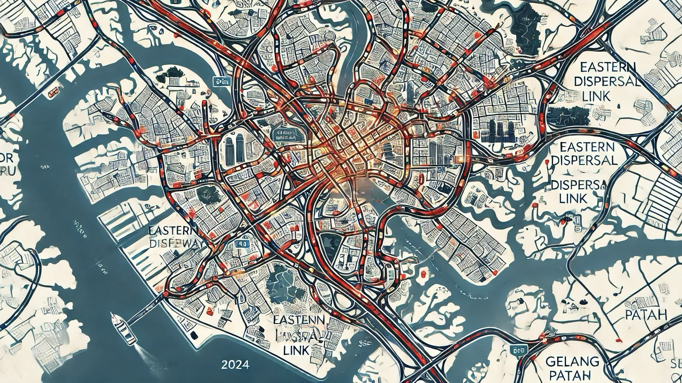
MAP

Slide 10
DATA-driven approach
(a)Big Data and Internet of Things (IoT)
(b)Machine learning model
(c)Regression model for traffic analysis
(d)Reinforcement learning for traffic signal control

Slide 11
Future Trends
Recently focused technologies can also provide support for traffic flow analysis
(a)Autonomous driving technology for vehicles
(b)Smart cities and traffic management systems
(c)AI-driven real-time traffic control systems
(d)Dynamic traffic assignment (DTA)

Slide 12
RESEARCH METHODOLOGY

Slide 13
Data Collection Methods
(a)Manual counting is performed through monitoring records on traffic lights.
(b)Automatic counting is performed through cameras installed at key intersections.
(c)Counting traffic at intersections through drones or counting vehicles
(d)Collecting data through third-party data platforms (such as Google Maps, Waze platforms)
(e)Directly collecting data from government agencies and traffic management departments

Slide 14
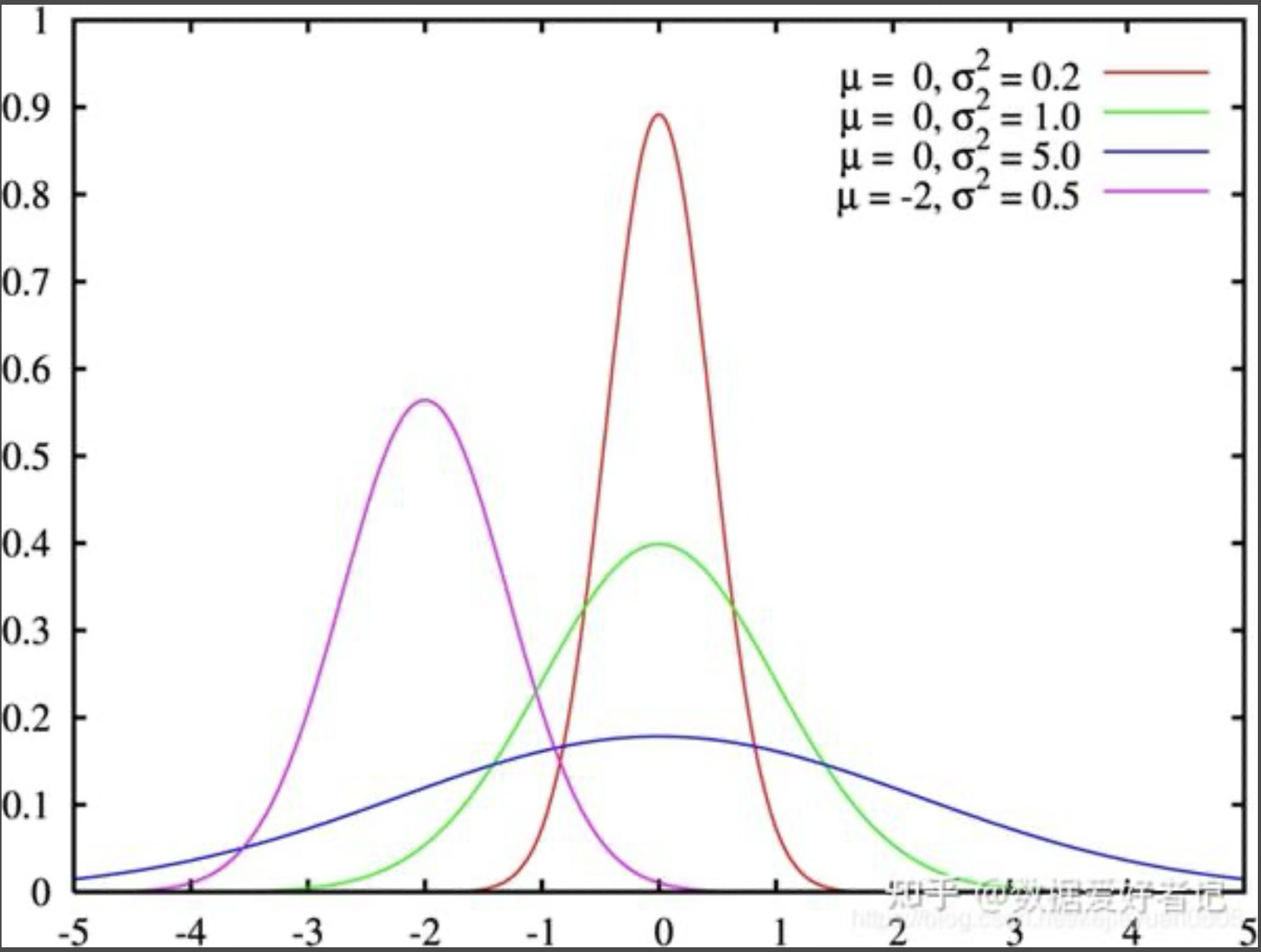
Data preprocessing methods
Handling missing values ​​in data
Remove duplicate values
Unified data format

Slide 15
Model selection and construction method
(a)Time series model
(b)Specific classification model
(c)Clustering classification model

Slide 16
INITIAL FINDINGS

Slide 17
Previously used data sources and statistical methods
intelligent traffic information system, crowdsourcing-based traffic information system, social geography network, open transportation system and online car-hailing application network called Grab Taxi.
OSM, or Open Street Map, is an open source map application that allows third-party editing. The traffic flow data for Johor Bahru, Malaysia was exported from this website.

Slide 18
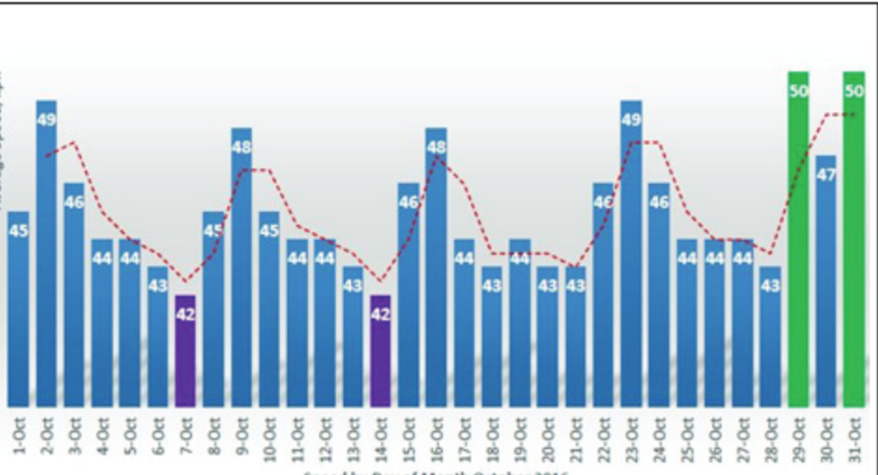
Traffic analysis map of Johor Bahru area

Slide 19
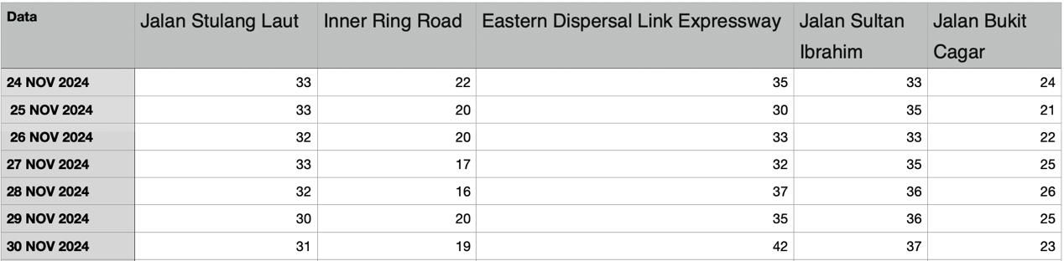
Traffic flow analysis of each road
The figure below shows the average speed of each street from November 24 to 30, 2024. It is observed that the traffic speed of Inner Ring Road and Jalan Bukit Cagar is slower compared to other roads.

Slide 20
Conclusion and Future Works

Slide 21
Summary
This study, through an in-depth analysis of traffic flow information in Johor Bahru, Malaysia, shows the causes of congestion during peak hours on major streets and the characteristics of different streets and areas. This study not only provides data support for Johor Bahru’s traffic problems, but also provides a basis for urban planning.

Slide 22
Future Works
1. The data collected at this stage is limited to a few main streets and is not complete. In the future, data from more street areas can be collected to improve the reliability of the data.
2. The data processing tools currently used are not complex enough to show more in-depth information. Technical iterations can be performed later to use more advanced data analysis tools.
3. Conduct more diversified data analysis, such as adding climate factors, population factors, sound effects, etc.

Slide 23
YouTube video link
https://youtu.be/eY70mVIc4jI

Slide 24


